Slide 1
Working While Receiving Benefits
2021
Presented by:
Hillary Hatch
Area Work Incentive Coordinator, SSA

Slide 2
Disability Programs
Title II
SSDI
Social
Security Disability Insurance
Medicare
Title XVI
SSI
Supplemental Security
Income
Medicaid

Slide 3
Social Security’s Definition of Disability
A medical condition or combination of impairments preventing substantial gainful activity for at least 12 months, or expected to result in death. The determination also considers age, education & work experience.
www.socialsecurity.gov

Slide 4
What is Substantial Gainful Activity?
Work is “substantial” if it involves doing significant physical or mental activities or a combination of both.
If your impairment is anything other than blindness, earnings averaging over $1,310 a month generally demonstrate SGA. Blind SGA is $2,190.
www.socialsecurity.gov

Slide 5
SSDI vs. SSI
Social Security Disability Insurance | Supplemental Security Income
Payments come from the Social Security trust funds and are based on a person’s earnings. Paid on the 3rd of the month of a Wednesday. | Payments come from the general treasury fund, NOT the Social Security trust funds. SSI payments are not based on a person’s earnings. Paid on the 1st of the month.
An insurance that workers earn by paying Social Security taxes on their wages. | A needs-based public assistance program that does not require a person to have work history.
Pays benefits to disabled individuals who are unable to work, regardless of their income and resources. | Pays disabled individuals who are unable to work AND have limited income and resources.
Benefits for workers and for adults disabled since childhood. Must meet insured status requirements. | Benefits for children and adults in financial need. Must have limited income and limited resources.
www.socialsecurity.gov

Slide 6
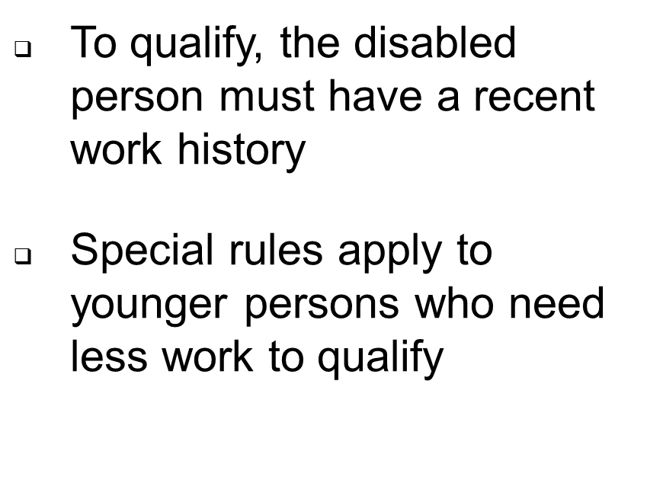
Social Security Disability Insurance (SSDI)
www.socialsecurity.gov

Slide 7
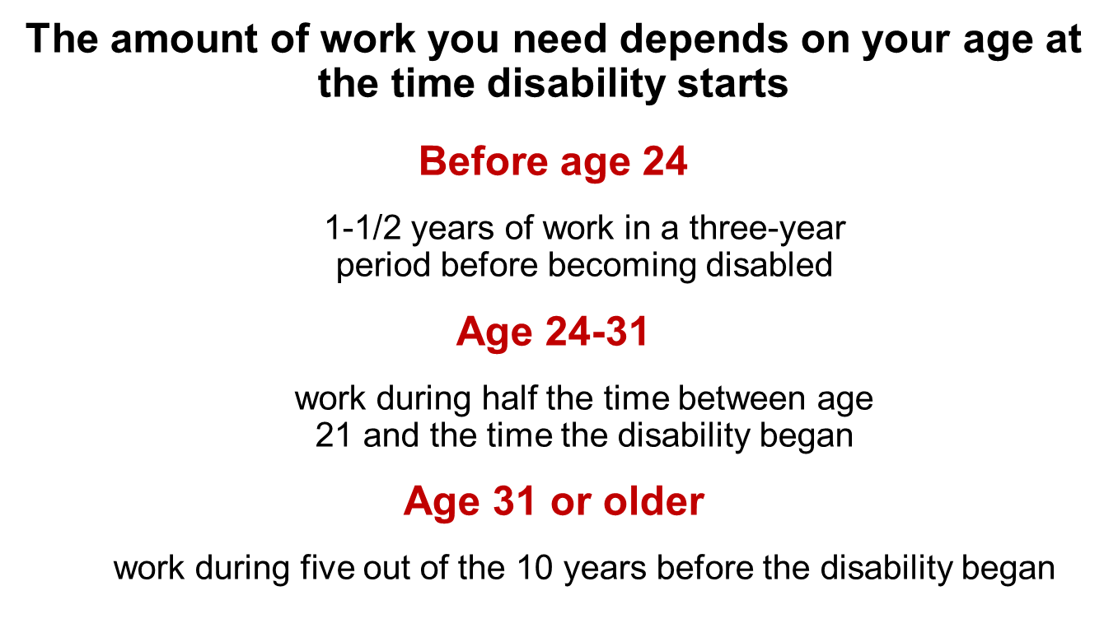
Work Requirements
www.socialsecurity.gov

Slide 8
Work Credits
When you work and pay Social Security taxes, you earn up to a maximum of 4 work credits each year.
The work credits are based on the total amount of your wages or self-employment income during the year.
For each $1,470 in gross earnings you get one credit, max. of 4 credits per year.
.
www.socialsecurity.gov

Slide 9
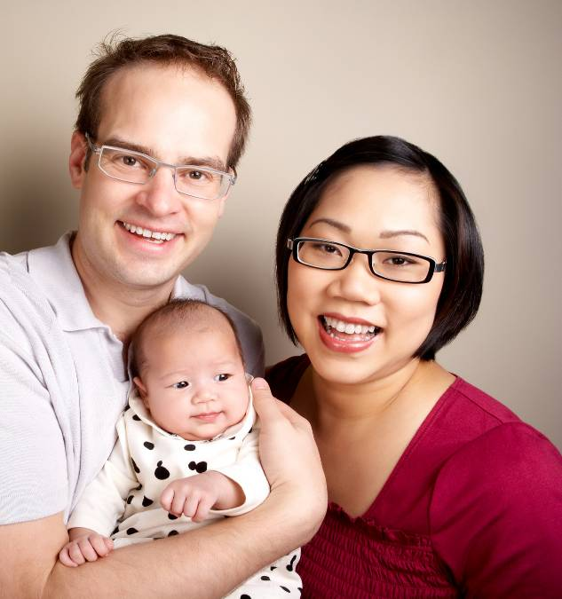
Benefits for the Family
Spouse
At age 62
At any age if caring for child under 16 or disabled
Divorced spouses may qualify
Child
Not married under age 18 (under 19 if still in high school)
Not married and disabled before age 22
www.socialsecurity.gov

Slide 10
What Are Work Incentives?
Employment support provisions to assist beneficiaries in moving from benefit dependency to independence.
Designed to help beneficiaries enter, re-enter, or stay in the workforce by protecting their eligibility for cash payments and/or health care.
www.socialsecurity.gov

Slide 11
SSDI ONLY EMPLOYMENT SUPPORTS
Trial Work Period (TWP)
Extended Period of Eligibility (EPE)
Continuation of Medicare Coverage
Medicare for Persons with Disabilities Who Work
https://www.ssa.gov/redbook/eng/ssdi-only-employment-supports.htm
www.socialsecurity.gov

Slide 12
Trial Work Period (TWP)
The TWP allows SSDI beneficiaries to test their ability to work and:
Receive full SSDI benefits regardless of earnings
TWP starts when gross earnings are more than $940 for 2021 or work more than 80 hours in self-employment in a month
TWP continues until 9 TWP service months accumulate (not necessarily consecutive) within a 60-month rolling period
www.socialsecurity.gov

Slide 13
Trial Work Period (TWP)
Count back 60 months from the 9th TWP month
Months before the 60-month period do not count
The TWP continues until 9 TWP months are worked within a 60-consecutive month period
9th month earnings went over TWP level: 06/19
3 months were prior to the 60 month period, so only 6 TWP months are used as of 06/19
1St TWP Month:12/08
02/13; 03/13
09/14; 08/15; 09/16; 01/19; 05/19
TWP Continues until
9 TWP service months fall
within a 60-consecutive
month period
60 Month Period
07/14
06/19

Slide 14
Extended Period of Eligibility (EPE)
EPE is 36-month re-entitlement period
During the EPE:
-If work or monthly earnings are below SGA, benefits are payable
-If work or monthly earnings are above SGA, benefits are suspended
EPE begins with the first month after the TWP ends
SGA after EPE results in benefit termination.
www.socialsecurity.gov

Slide 15
Extended Period of Eligibility (EPE)
Cessation Month and Grace Period:
Cessation Month- First month the beneficiary engages in SGA in the EPE
Grace Period- The two months following the cessation month. Benefits are paid whether or not the beneficiary is earning over SGA.
Benefit Termination Month:
The first month no benefits are payable after the EPE
*Note: The EPE can continue indefinitely if SGA is never performed after the 36th month
www.socialsecurity.gov

Slide 16
Extended Period of Eligibility (EPE)
Month TWP ends (T9)
Month EPE Begins (E1)
Re-entitlement Period Ends (E36)
EPE Continues (E37 - On)
9-Month
Trial Work Period
36-Month
Re-Entitlement Period
EPE continues until
SGA is preformed after the 36th
month
www.socialsecurity.gov

Slide 17
Continuation of Medicare Coverage
Although cash benefits may cease due to work, continued health insurance is possible.
Most beneficiaries who work will continue to receive at least 93 consecutive months of Part A; Part B (if enrolled); and Part D (if enrolled). There is no premium for Part A.
The 93 months start the month after the last month of the TWP.
To qualify, beneficiary must already have Medicare and be working at SGA level but not medically improved.
www.socialsecurity.gov

Slide 18
Medicare for Persons with Disabilities Who Work
A disabled individual may buy Medicare coverage as long as he/she remains medically disabled.
To qualify, the individual:
Must be under age 65; and
Continue to have a disabling impairment; and
Medicare stopped due to work.
Premium Hospital Insurance (Part A) is available for $471.00 per month. Premium Supplemental Medical Insurance (Part B) is available for $148.50 per month in 2021.
www.socialsecurity.gov
Notes:
A beneficiary can buy Premium Hospital Insurance (Part A) at the same monthly cost which uninsured eligible retired beneficiaries pay ($437.00 per month for 2019 or $240.00 per month if the beneficiary has earned 30 quarters of coverage); and
A beneficiary can buy Premium Supplemental Medical Insurance (Part B) at the same monthly cost which uninsured eligible retired beneficiaries pay ($135.50 per month for 2019); or
A beneficiary can buy Hospital Insurance separately without Supplemental Medical insurance. A beneficiary can buy Supplemental Medical Insurance only if they buy Hospital Insurance.

Slide 19
SSDI- Summary of Returning to Work
The Trial Work Period
Lasts for 9 months
Does not have to be 9 consecutive months
Must take place within 60 months
The Extended Period of Eligibility
36-month re-entitlement period
Under SGA, cash payment received; Over SGA, no cash payment
Benefits will terminate if over SGA after EPE re-entitlement period
Expedited Reinstatement
Stop working at SGA level, and
Disability is the same as or related to current disability, and
Make request within 5 years of when benefits ended
Medicare
If disability payments ended due to work, coverage will continue if disability still meets rules
Can continue for at least 93 months after TWP ends
www.socialsecurity.gov

Slide 20
SSDI AND SSI EMPLOYMENT SUPPORTS
Subsidies and Special Conditions
Impairment-Related Work Expenses (IRWE)
Plan to Achieve Self-Support (PASS)
Ticket to Work
Expedited Reinstatement (EXR)
https://www.ssa.gov/redbook/eng/ssdi-and-ssi-employments-supports.htm
www.socialsecurity.gov

Slide 21
Subsidies and Special Conditions
What is a subsidy?
A “subsidy” is support provided by an employer that may result in receiving more pay than the actual value of the services performed.
What are special conditions?
“Special conditions” refers to support and on the job assistance provided by an employer, or by someone other than the employer, for example, a vocational rehabilitation agency. Because of this support, a person may receive more pay than the actual value of the services performed.
www.socialsecurity.gov

Slide 22
Impairment-Related Work Expenses (IRWE)
We deduct the cost of certain impairment-related items and services that are needed to work from gross earnings when we decide if work is SGA.
The beneficiary must pay for the item themselves (no reimbursement from 3rd party)
The claimant must pay cash (no in-kind payments)
Examples include wheelchairs, certain transportation costs and specialized work-related equipment.
Example: Beneficiary is earning $1400.00 per month in gross wages. His monthly co-pay for his medications is $100.00.
$1400 - $100 = $1300 - This is countable income when determining SGA.
www.socialsecurity.gov

Slide 23
Impairment-Related Work Expenses (IRWE)
Type of Expense | Example
Transportation Costs | The cost of structural or operational modifications to vehicle that is needed to travel to work. The cost of driver assistance or taxicabs if public transportation is not available or not accessible.
Attendant Care Services | Services performed in the work setting. Services performed to help prepare for work, the trip to and from work and after work.
Service Animals | Expenses paid in owning a guide dog or other service animal who enables beneficiary to overcome functional limitations in order to work.
Medical Devices | Deductible devices include wheelchairs, dialysis equipment, pacemakers, respirators, traction equipment, and braces.
Prosthesis | Artificial hip, artificial replacement of an arm, leg, or other parts of the body.
Residential Modifications | Employed outside of home- modifications to exterior to permit access to the street or transportation. Self-employed at home- modifications inside to create workspace to accommodate impairment.
Prescription Drugs | Regularly prescribed medical treatment or therapy that is necessary to control disabling condition. This includes co-payments and insurance deductibles.
Other Items and Services | Assistive technology that people with disabilities use for employment–related purposes; such as software applications, computer support services, and special tools which have been specifically designed to accommodate the person’s impairment
https://secure.ssa.gov/apps10/poms.nsf/lnx/0500820555!opendocument
www.socialsecurity.gov

Slide 24
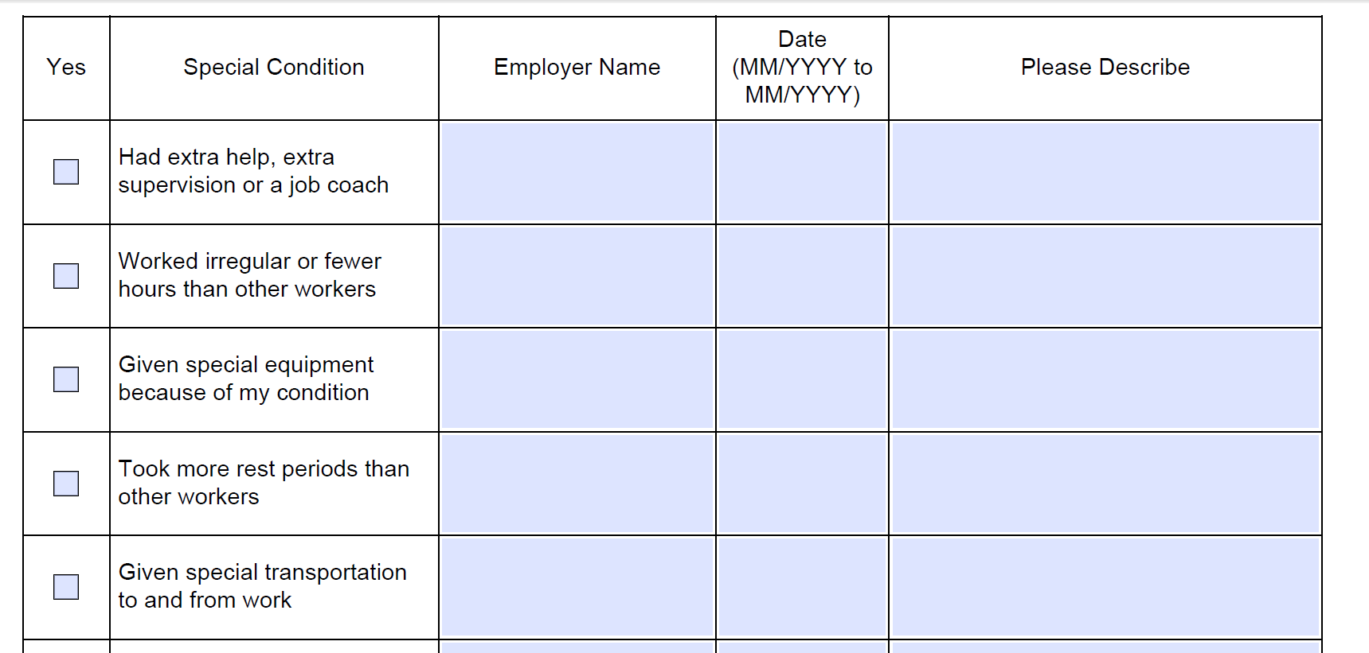
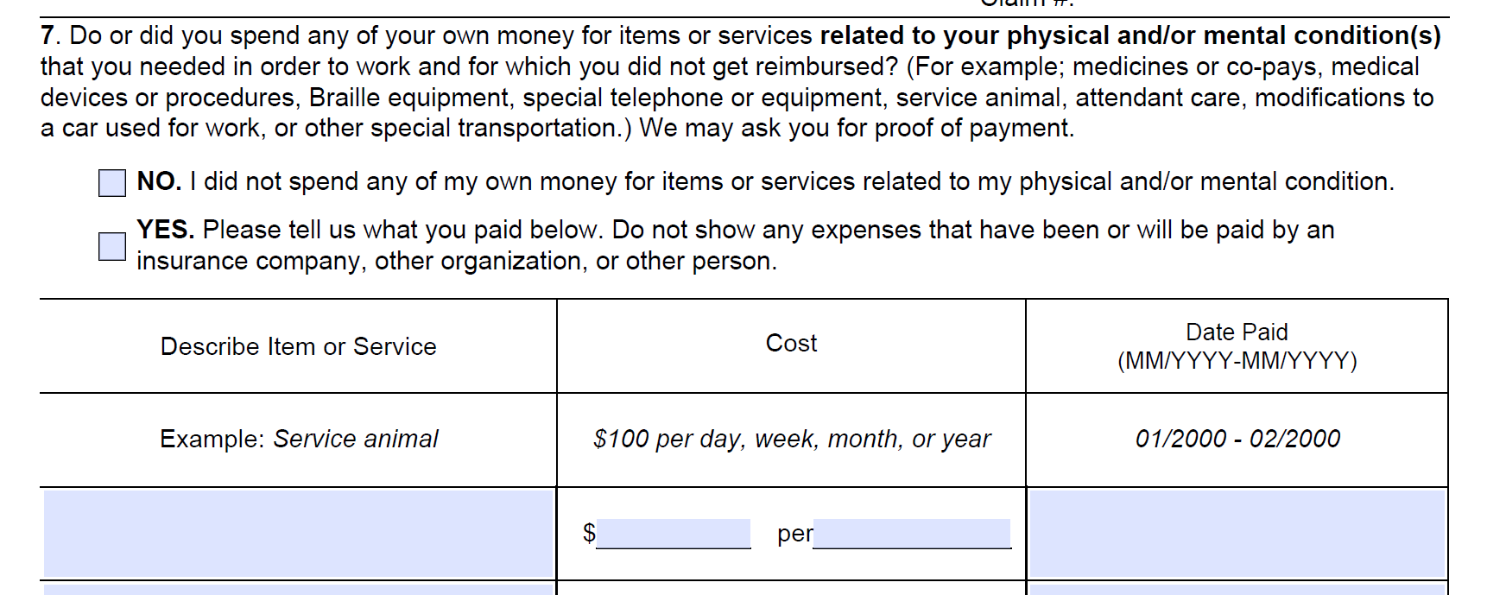
Form SSA-821 Work Activity Report
SSA-821 is used to document work activity and work incentives when SSA is making SGA decisions.
https://www.ssa.gov/forms/ssa-821.pdf
Beneficiaries complete this form to document special conditions, subsidies and IRWEs so decisions are based on the real value of the work.
www.socialsecurity.gov

Slide 25
Plans to Achieve Self-Support (PASS)
What is a PASS?
A PASS allows an individual to set aside other income besides SSI and/or resources for a specified time period to pursue a work goal that will result in the reduction or elimination of SSI or SSDI benefits.
How does it work?
We do not count the income set aside under the PASS when we figure the SSI payment amount. We do not count the resources set aside under the PASS when we determine initial and continuing eligibility for SSI.
Who can have a PASS?
If a person receives SSI or could qualify for SSI after setting aside income or resources to pursue a work goal, a person could benefit from a PASS.
https://www.ssa.gov/ssi/spotlights/spot-plans-self-support.htm
www.socialsecurity.gov

Slide 26
Plans to Achieve Self-Support (PASS)
What kinds of expenses can a PASS help pay for?
School or training expenses- tuition, fees, books and supplies
Uniforms, special clothing, safety equipment, tools
Attendant care of child care expenses
Transportation for work
Employment services such as a job coach
Supplies to start a business
https://www.ssa.gov/ssi/spotlights/spot-plans-self-support.htm
www.socialsecurity.gov

Slide 27
Plans to Achieve Self-Support (PASS)
A Sample PASS (SSDI Only)
Example – SSDI Being Excluded under an approved PASS
Maria wants to go to school and become a paralegal.
She receives $1000 in SSDI benefits
Maria’s employment goal needs to be expected to generate enough income to eliminate SSDI. (Have expected earnings over $1,310 per month SGA for 2021)
- Maria determines she needs $1000 per month for tuition, books, and school supplies.
Maria must use the SSI payment of $794 for living expenses and use the PASS funds of $1000 for approved plan expenses.
PASS is self-funded but the math has to make sense!
www.socialsecurity.gov

Slide 28
Ticket to Work (TTW)
Free and voluntary program that can help beneficiaries go to work, get a good job that may lead to a career, and become financially independent, all while they keep their Medicare and Medicaid.
Individuals who receive SSI or SSDI benefits because of a disability and are age 18 through 64.
Many beneficiaries are eligible to obtain services from a state VR agency or another approved provider of their choice.
We call these providers Employment Networks (ENs). ENs are private organizations or government agencies that have agreed to work with Social Security to provide employment services to beneficiaries with disabilities.
www.socialsecurity.gov

Slide 29
Ticket to Work (TTW)
For more information on the TTW Program, including a list of approved ENs, call:
1-866-YOURTICKET (1-866-968-7842) or for TTY call 1-866-833-2967 between 8 a.m. to 8 p.m. Eastern time Monday through Friday.
Or
Email: support@choosework.ssa.gov
Or
Find information online at www.socialsecurity.gov/work
www.socialsecurity.gov

Slide 30
Expedited Reinstatement (EXR)
What is EXR?
EXR is a safety net for people who successfully return to work and lose their entitlement to SSDI and/or SSI benefits because of work and earnings.
Allows individuals to request benefits be reinstated without filing a new application (if request made within 5 years from month benefits ended)
How does EXR help?
The EXR provision allows an individual to receive up to 6 months of temporary cash benefits while we conduct a medical review to decide if we can reinstate benefits. An individual may also be eligible for Medicare and/or Medicaid during this provisional benefit period.
https://www.ssa.gov/disabilityresearch/wi/exr.htm
www.socialsecurity.gov

Slide 31
SSI ONLY EMPLOYMENT SUPPORTS
Earned Income Exclusion
Student Earned Income Exclusion (SEIE)
Special SSI Payments for Persons Who Work- Section 1619(a)
Medicaid While Working- Section 1619(b)
https://www.ssa.gov/redbook/eng/ssi-only-employment-supports.htm
www.socialsecurity.gov

Slide 32
Income Exclusions
SSA does not count the first $65 of the earnings received in a month, plus one-half of the remaining earnings. This means we count less than one-half of earnings when we figure the SSI payment amount.
We apply this exclusion in addition to the $20 general income exclusion.
We apply the $20 general income exclusion first to any unearned income received.
https://www.ssa.gov/OACT/COLA/incomexcluded.html
www.socialsecurity.gov

Slide 33
Earned Income Exclusion
Example 1- Earned Income Only
Total monthly income = $385 (Gross wages)
$385 (Gross wages)
-85 (Not counted)
=$300 divided by 1/2 =$150 (Countable income)
$794 (SSI Federal Benefit Rate)
-150 (Countable income)
=$644 (SSI Federal Benefit)
Example 2- Earned Income and Unearned Income
Total monthly income
$200 Gross wages
$185 SSDI benefits
=$385 Total
$185 SSDI
$20 (general income exclusion)
= $165 countable unearned income
$200 Gross wages
$65 earned income exclusion
=$135 divided by ½ = $67.50 countable earned income
$794 (SSI Federal Benefit Rate) – $165 (countable unearned income) = $629 - $67.50 (countable earned income) = $561.50 (SSI Federal Benefit)
Although SSI benefits will be reduced, overall income will be more when a beneficiary is working!
www.socialsecurity.gov

Slide 34
Student Earned Income Exclusion
For individuals under age 22 and regularly attending school, we do not count up to $1,930 of earned income per month when we figure the SSI payment amount. The maximum yearly exclusion is $7,770.
Regularly Attending School-
In a college or university for at least 8 hours a week; or
In grades 7-12 for at least 12 hours a week; or
In a training course to prepare for employment for at least 12 hours a week (15 hours a week if the course involves shop practice); or
Home schooling if instructed in grades 7-12 for at least 12 hours a week
https://www.ssa.gov/ssi/spotlights/spot-student-earned-income.htm
www.socialsecurity.gov

Slide 35
Student Earned Income Exclusion
SSI recipient is 20 years old and currently attending college 12 hours per week. During summer break he starts working and earns the following amounts:
June $1500
July $1600
August $1400
He continues to work part-time once he returns to school and earns the following amounts:
September $600
October $700
November $600
December $500
Total earnings from June-December, $6900. This is under the $7,770 maximum yearly exclusion so no benefits would be reduced.
Total Earnings $4500
Total Earnings $2400
https://www.ssa.gov/ssi/spotlights/spot-student-earned-income.htm
www.socialsecurity.gov

Slide 36
Section 1619(a)
A beneficiary can receive SSI cash payments even when earned income is at the SGA level.
To qualify, a beneficiary must:
Have been eligible for an SSI payment for at least 1 month before SGA level work begins; and
Still be disabled; and
Meet all other eligibility rules, including income and resource tests.
Under 1619(a), a beneficiary can receive their gross income from wages, an SSI payment (calculated based on wages) and Medicaid.
www.socialsecurity.gov

Slide 37
Section 1619(a)
Example
Beneficiary has been receiving SSI for six months and returns to work making $1300 per month in gross wages.
$1300 (gross wages)
$20 (general income exclusion)
= $1280
$65 (earned income exclusion)
= $1215 divided by ½ = $607.50 (countable income)
$794 (Federal Benefit Rate) - $607.50 (countable income) = $186.50
www.socialsecurity.gov

Slide 38
Section 1619(b)
After returning to work, Medicaid coverage can continue even if earnings become too high for an SSI cash payment.
To qualify, a beneficiary must meet ALL of the following:
Were eligible for an SSI cash payment for at least 1 month;
Would be eligible for cash payment except for earnings;
Still be disabled;
Still meet all other eligibility rules, including the resources test;
Need Medicaid in order to work; and
Have gross earned income that is insufficient to replace SSI, Medicaid, and any publicly funded attendant care.
Under 1619(b), a beneficiary will receive income from gross wages and Medicaid but no SSI payment.
https://www.ssa.gov/disabilityresearch/wi/1619b.htm
www.socialsecurity.gov

Slide 39
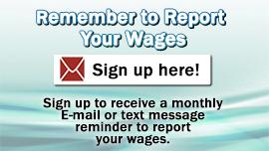
How to Report Work
Notify Social Security of any changes in work activity:
Start or stop work;
Work has been reported but duties, hours or pay has changed;
Start paying for expenses that are needed in order to work due to the disability
ONLINE WAGE REPORTING FOR SSDI and SSI BENEFICIARIES
Report changes in work activity by phone, fax, or mail.
Call our toll-free number 1-800-772-1213 between 7 a.m. and 7 p.m. Monday-Friday.
For SSI recipients-
-Automated wage reporting
telephone system
-Mobile wage reporting application

Slide 40
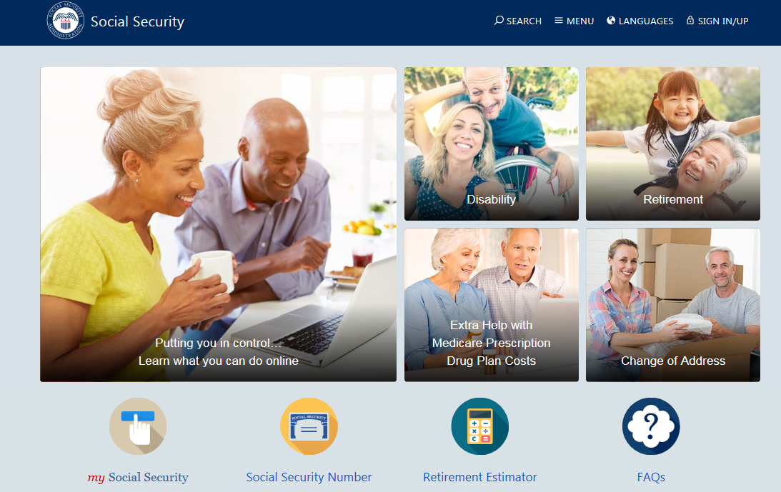
Create a my Social Security Account
@ socialsecurity.gov
Notes:
my Social Security is a convenient way to access valuable personalized Social Security information, whether you’ve been working and paying Social Security taxes or now are receiving Social Security benefits. And you can check your online account just about whenever you want at www.socialsecurity.gov/myaccount.

Slide 41
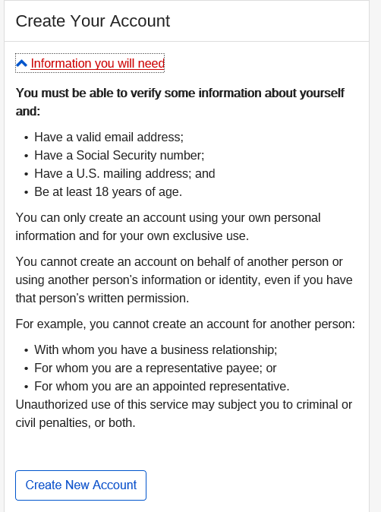

Slide 42
Key Transactions with a
my Social Security account
Request a Replacement Social Security Card
Get a Benefit Verification Letter
Check Application Status
Online Wage Reporting
Notes:
The agency is highlighting 6 key transactions that can be conducted with a my Social Security account.
Replacement SS Card
Application Status
Benefit Verification Letter
1099
Direct Deposit
Change of Address

Slide 43
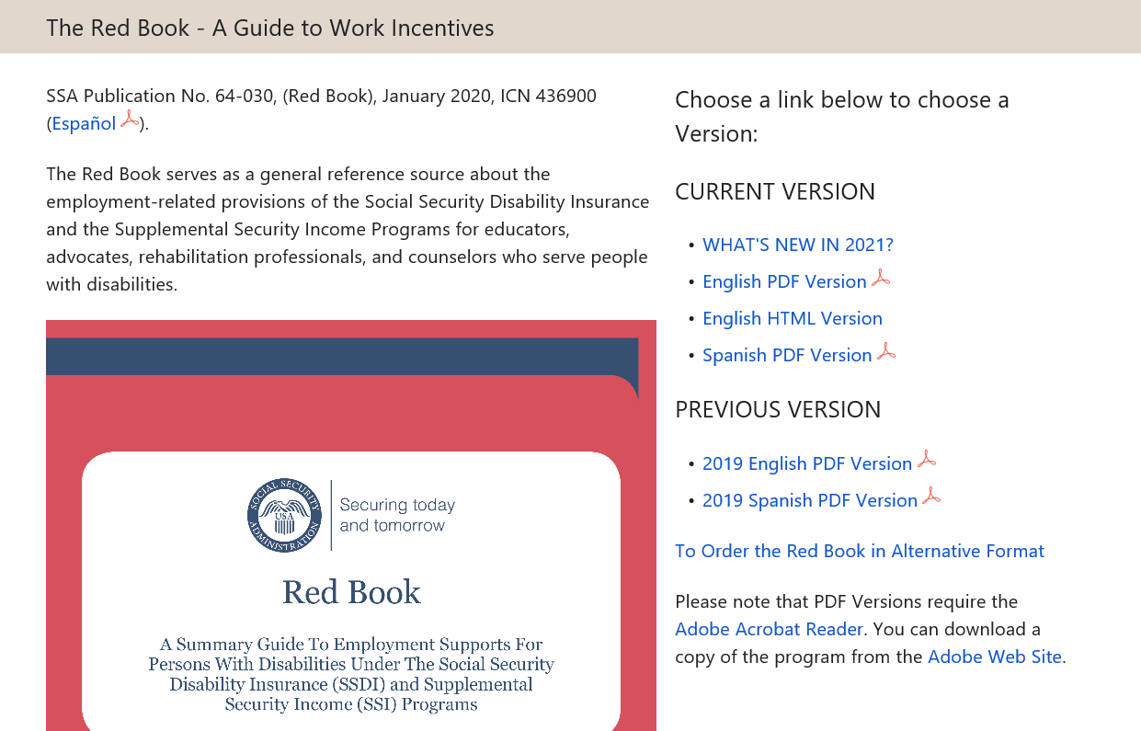
The Best Guide to Work Incentives
The Red Book is available at:
https://www.ssa.gov/redbook/

Slide 44
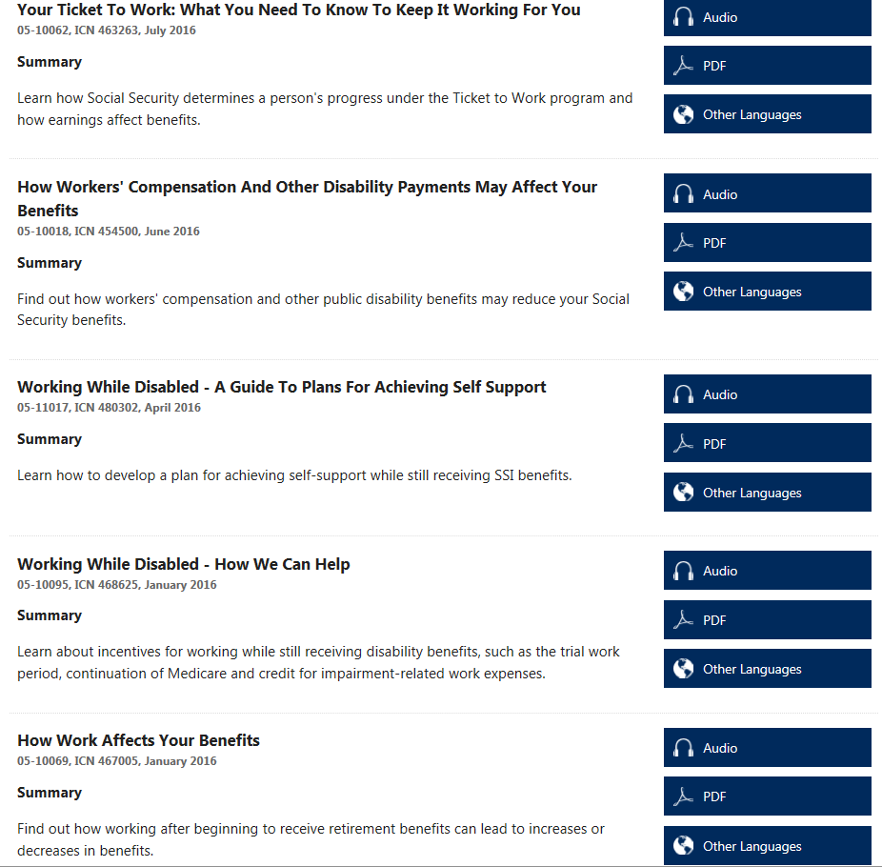
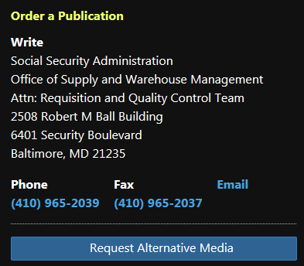
Ordering Publications
You can order any of the booklets and publications or download them for free at http://www.socialsecurity.gov/pubs/
Notes:
Request alternative media- formats include braille, audio cassette, audio cd, large print

Slide 45
Contacting Social Security
Visit the website
www.socialsecurity.gov
Call the toll-free number
1-800-772-1213
Specific questions can be answered from 7 a.m. to 7 p.m., Monday through Friday. Information is provided by automated phone service 24 hours a day.
If deaf or hard of hearing, call Social Security’s TTY number, 1-800-325-0778.
Notes:
When it comes to contacting Social Security, first place to go is our website. There is a lot of great information available online, can file for benefits online, if already receiving benefits and need to update information you can do that online through mySSA. So the website isn’t just about information but you and your clients can conduct business through our website.
Certain things cannot be done online or maybe you have a client that doesn’t have internet access or just prefers not to do business online. Call the 800# Schedule an appointment with the local office if needed.
Local office- You will want to call first, some services are not available on a walk-in basis. If your client does have to visit a local office, tell them to create a mySSA account while they are there, save them a trip in the future.

