Slide 1
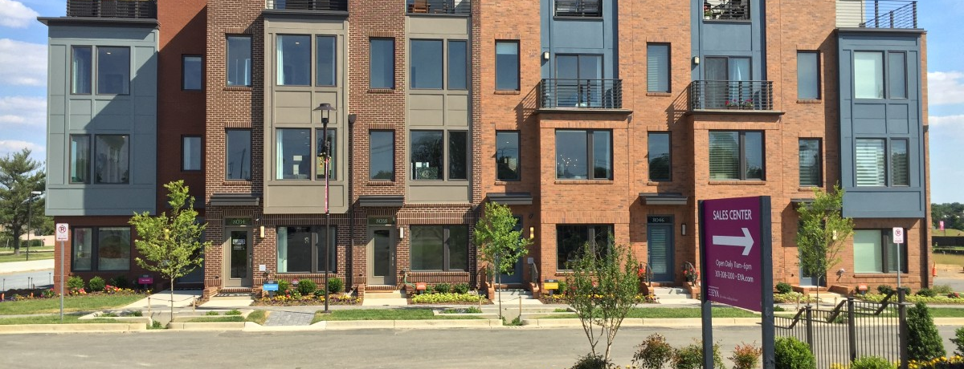

Affordable Housing Presentation
​​
January 18, 2022

Slide 2
2

Slide 3
3

Slide 4
4

Slide 5

5

Slide 6
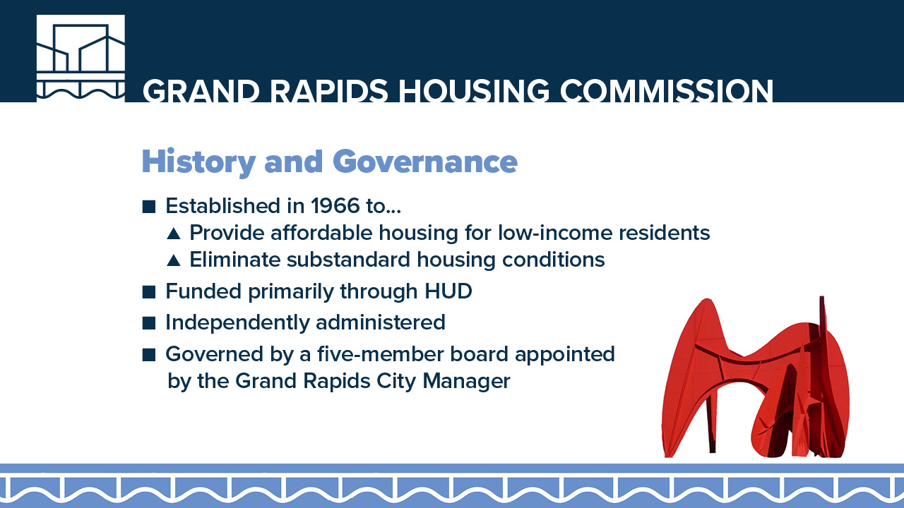
6

Slide 7
7

Slide 8
8

Slide 9
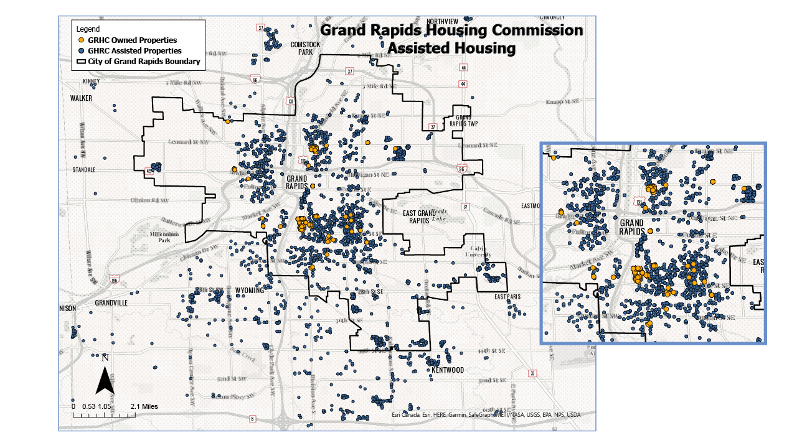
9

Slide 10
10

Slide 11
11

Slide 12
12

Slide 13
13

Slide 14
14

Slide 15
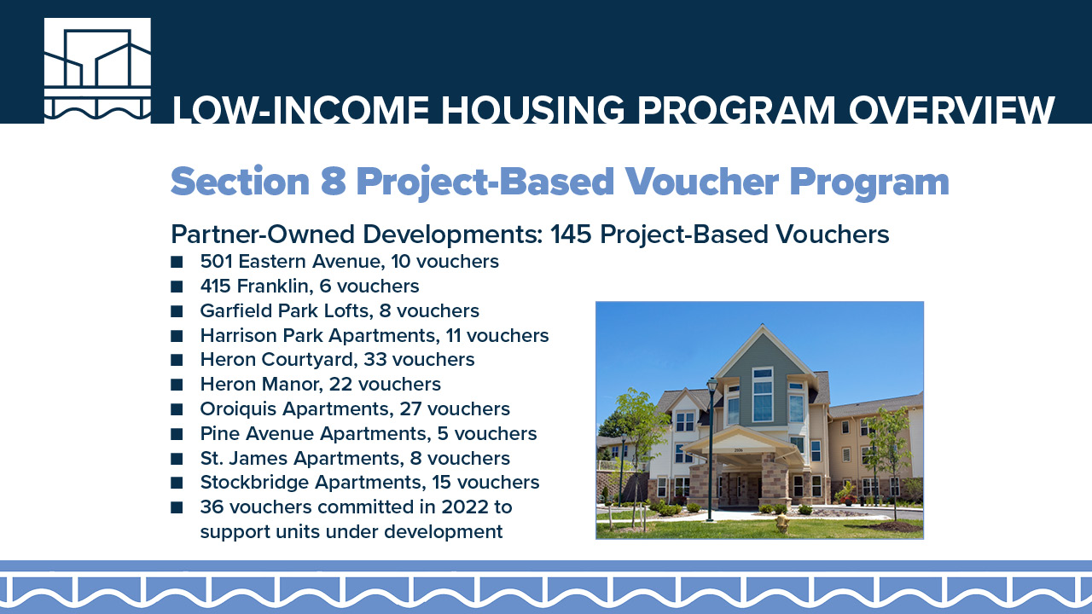
15

Slide 16
16

Slide 17
17

Slide 18
18

Slide 19
19

Slide 20
20

Slide 21
21

Slide 22
22

Slide 23

23

Slide 24
24

Slide 25
25

Slide 26
26

Slide 27
27

Slide 28
28

Slide 29

29

